Slide 1

Team Leader:
Mokshith Balidi
Codes & Bytes
Team Members:
Aishwarya Reddy
Vrithika Boggarapu
Nithin Soma
Varshith Reddy
Kireeti Reddy

Slide 2

Problem Statement
Problem Statement
Student dropout analysis for school education
Problem Statement ID: 1362
IMPORTANCE:
Identifying At-Risk Students
Resource Allocation
Policy Development
Social and Economic Impact
Educational Equity

Slide 3

SOLUTION ARCHITECTURE
Brief Description
Our solution is centered around "Full Stack Web Development”.
It is a comprehensive web application developed using React for the frontend.
It offers advanced dropout analysis and prediction capabilities to address the challenges in the education sector.
Key Features
Technology Stack
In-Depth Analysis: Our platform conducts detailed analysis of student data, including attendance, academic performance, and socio-economic factors.
Predictive Model: Utilizing machine learning algorithms, our system predicts student dropout risk with high accuracy.
User-Friendly Interface: A user-friendly dashboard for educators and administrators to access insights effortlessly.
HTML, CSS, JavaScript, React, Flask, Python (for machine learning).

Slide 4

What
SetS us
apart
Problem Solution
Call to Action
Our system analyzes historical student data and employs predictive modeling to identify students at risk of dropping out.
We invite educational institutions to explore our solution, adopt proactive strategies, and be a part of the effort to reduce student dropout rates.
Uniqueness
What sets our solution apart is the seamless integration of cutting-edge technology and data-driven insights, enabling educational institutions to take proactive measures in reducing student dropout rates.

Slide 5

DEVELOPEMENT PROCESS
Development Phases
Tools and Technologies Used
Challenges Faced

Slide 6

Development Process
DEVELOPMENT PHASES
TOOLS AND TECHNOLOGIES USED
Planning: Defining project goals, objectives, and requirements
Design: Creating a user-friendly interface using HTML, CSS, JavaScript and React.
Implementation: Writing the analysis code in Python, utilizing libraries such as Numpy, Pandas, and Matplotlib.
Backend Development: Building the server-side logic with Flask for a seamless user experience.
Testing: Rigorous quality assurance, including unit and integration testing.
Frontend: HTML, CSS, JavaScript and React for an intuitive user interface.
Analysis Code: Python, along with Numpy, Pandas, and Matplotlib for data analysis and visualization.
Prediction: We employed various tools and technologies, including Python's Scikit-Learn library for machine learning, ensemble techniques, and predictive modeling.
Backend: Flask, providing a robust foundation for server-side functionality.
CHALLENGES FACED
Overcoming data collection and preprocessing challenges, we developed custom algorithms to ensure data quality. The Flask backend implementation presented complexities that required systematic problem-solving.

Slide 7
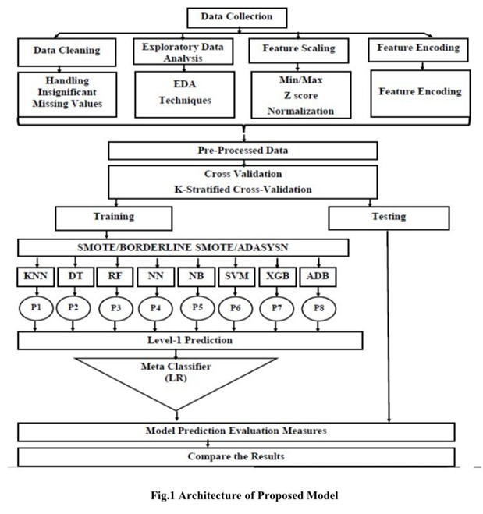
Training and Testing
Data Collection:
We collected data from foreign websites to build a comprehensive dataset for our dropout prediction model.
Data Preprocessing:
Before training our model, we rigorously preprocessed the dataset, addressing missing values and ensuring data quality.
Training Data Split:
We divided our dataset into a training set (70%) and a testing set (30%) for model development and evaluation.
Model Evaluation:
We rigorously tested our model using the reserved testing data to assess its predictive accuracy, sensitivity, and specificity.
Cross-Validation:
Cross-validation techniques were employed to validate the model's robustness and generalize its predictive capabilities.
Meta-Classifier:
Our Meta-Classifier acts as an ensemble technique, combining the predictions of multiple base classifiers to enhance prediction accuracy.

Slide 8

Our Goals
Empower Educators
Data-Backed Decision Making
We seek to empower educators with data-driven insights, enabling them to identify and support at-risk students more effectively.
Our goal is to foster a culture of data-backed decision making in educational institutions, enhancing the overall quality of education.
Adoption and Scalability
Recognition and Support
We aspire to see our solution adopted by a growing number of educational institutions across India, leading to a broader societal impact.
Our ultimate goal is to earn recognition for our contribution to education and garner support from institutions, stakeholders, and educational communities.

Slide 9
THANK YOU
“If you look at history, innovation doesn’t come just from giving people incentives; it comes from creating environments where their ideas can connect.”
—Steven Johnson

